Slide 1

Static Modeling using Class Diagrams
  Classes, Objects, Attributes and Operations
  Visibility of attributes and operations
  Class-Scope Attributes, Attributes with default values
  Association, Multiplicity, Role-Name
  Qualified Association, Association Class
  Ternary Association, Recursive Association
  Multiple Association between two classes
  Aggregations and its types: Composite and Shared
  Generalization and sub-class partitioning (complete,
incomplete, disjoint, Overlapping)
  Generalization Set
  Interfaces and their realization
  Packages and Grouping of classes into Packages
  Parameterized Classes

Slide 2
Class
  Base over which the structure of object orientation is built.
  Signifies the conceptual view of a system.
  A college library system has concepts like book, magazine, library attendant, librarian, student, teacher etc.
  Object is fundamental in building object-oriented systems
  But static view focuses on the classes from which the objects are instantiated.

Slide 3
Class contd..
  Classes can be drawn at conceptual level and implementation level.
  At conceptual level each attribute of the book in the college library system can have corresponding set and get operations in order to allocate and retrieve the data respectively.
  Implementation can be done by using a GUI consisting of forms and Text boxes and command buttons.

Slide 4
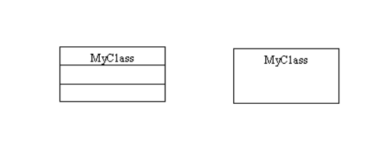
Classes and Objects
  A class is a concept within the application domain being modeled.
  A class is what the programmer designs and programs whereas an object is created from a class at runtime.

Slide 5
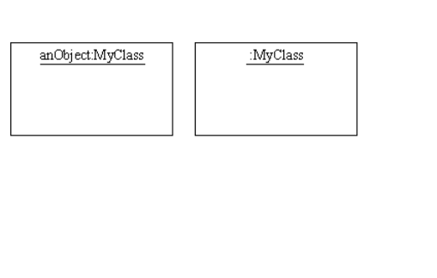
Representation of an Object

Slide 6
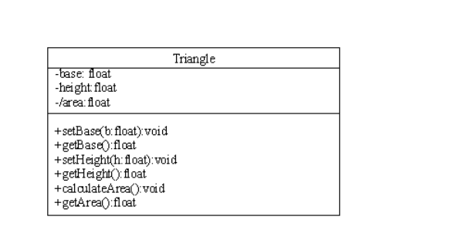
Attributes and Operations
  An attribute represents some property of an object.
  In general, an attribute is gettable as well as settable from outside the object.
  Some attributes are read-only i.e. they are only gettable, they cannot be assigned values. Represented by preceding attribute name by a ‘/’.

Slide 7
Operation Syntax
  Operation syntax:
visibility name(parameter-list):return-type { property-string}
where,
  parameter-list is a list of the formal parameters and each parameter is separated by a comma and has the following syntax:
name:type
  Visibility can either be public, private or protected.
  Property string indicates property values that apply to the given operation.
  E.g. +setBase(b:float):void
  +getBase():float
  +calculateArea():void

Slide 8
Visibility of Attributes and Operations
  Visibility indicates the extent to which an attribute or an operation belonging to a particular class can be referenced from outside the class.
  Three types: private, public and protected.
  Private visibility: If an attribute is private in a particular class, it is only visible to the object of that class.
  Even if the object has to modify a variable used to represent the attribute, it has to invoke a method to do so.
  E.g. If the attributes of Class Triangle i.e. base, height, area are declared as private, an object t1 of class Triangle cannot set a value for base and height directly.
  t1.base=10 //Not allowed
  t1. height=20 //Not allowed
  t1 has to invoke method setBase() and setHeight() to do the above tasks.

Slide 9
Visibility of Attributes and Operations contd..
  Similarly, the following fragment of code cannot be written as
  float baseval;
  baseval=t1.base;
  The code fragment has to be written in the following manner:
  float baseval;
  baseval=t1.getBase();
  UML symbol to denote private visibility: '-'.

Slide 10
Visibility of Attributes and Operations contd..
  If an operation in a class is private, then an object of that class cannot invoke it directly.
  class add{
  private int a=5;
  private int b=10;
  private int c;
  private void addfunc() {
  c=a+b;
  }
  } //end of add class

Slide 11
Visibility of Attributes and Operations contd..
  In the main program if code is inserted to create an object of class add and the following code fragment is given:
  a.addfunc();
  it will result in a compile-time error.
  The object has to invoke a public operation to do so.

Slide 12
Visibility of Attributes and Operations contd..
  Suppose a public operation called addNumbers() is added to the class add. The class structure becomes
class add{
private int a=5;
private int b=10;
private int c;
private void addfunc() {
c=a+b;
}
public void addNumbers(){
addfunc();
System.out.println("The sum of the two numbers is "
+c);
}
}

Slide 13
Visibility of Attributes and Operations contd..
  Now the object can successfully call the operation addNumbers() to perform the addition.
  Any class derived from the base class never inherits its private attributes and private operations.
  Public visibility: Public attributes and Public operations can be viewed and used outside the class in which they are declared. If the attributes in the class Triangle had public visibility then
  t1.base=10 // Allowed
  t1. height=20 //Allowed

Slide 14
Visibility of Attributes and Operations contd..
  The UML symbol to denote public visibility for attributes and operations is '+'.
  Any class derived from the base class inherits its public attributes and public operations.
  Protected visibility: This visibility is denoted by the '#' symbol. It is used to make a private member inheritable.

Slide 15
Class Scope Attribute & Operations
  It is shared between all objects of a particular class. It must be underlined.
  Created in the program only once when the first object of the class is created.
  There can be class-scope operations but they can access only class-scope attributes. They are also underlined.
  E.g. The attribute noOfTriangles

Slide 16
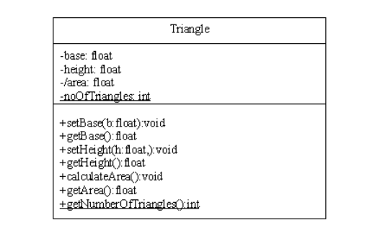
Depicting Class Scope Attributes & Operations

Slide 17
Mapping Class to Java Code
public class Triangle{
private float base;
private float height;
private float area;
private static int noOfTriangles;
public void setBase(float b){
}
public float getBase(){
}
public void setHeight(float h){
}

Slide 18
Mapping Class to Java Code
public float getHeight(){
}
public void calculateArea(){
}
public float getArea(){
}
public static int getNumberOfTriangles(){
}
}

Slide 19
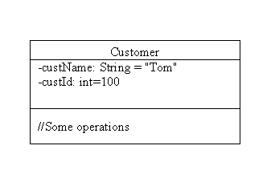
Depicting attributes with default values

Slide 20
Attributes with Default Values (Java code)
  Converting to the Java class,
public class Customer{
private String custName="Tom";
private int custId=100;
}
  Suppose an object c1 is created. The values for c1's copy of custName and custId will be Tom and 100 respectively.

Slide 21
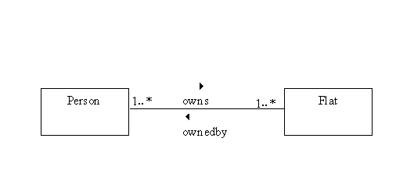
Association
  An association represents relationship between classes.

Slide 22
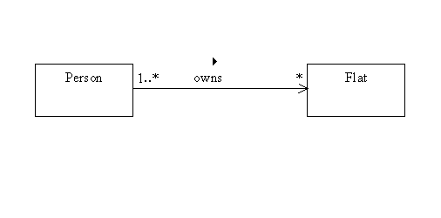
Depicting Navigability
  Navigability shown at the end of an association with the help of an arrow. If want to say that "A person owns zero or many flats" but we do not want to say anything explicitly about a flat being "owned by" person(s) we can draw the following diagram.

Slide 23
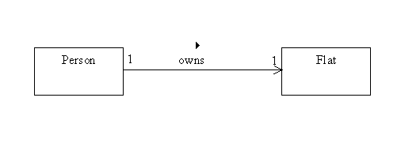
Case 1:One to One Unidirectional Association

Slide 24
Java Code
public class Person {
public Flat owns;
}
public class Flat {
}

Slide 25
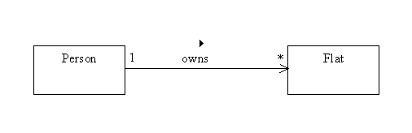
Case 2: One to Many Unidirectional Association

Slide 26
Java Code
import java.util.*;
public class Person {
public Collection owns;
}
public class Flat {
}

Slide 27
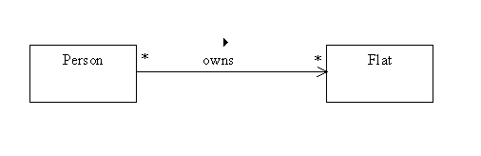
Case 3:Many to Many Unidirectional Association

Slide 28
Java Code
import java.util.*;
public class Person {
public Collection owns;
}
public class Flat {
}

Slide 29
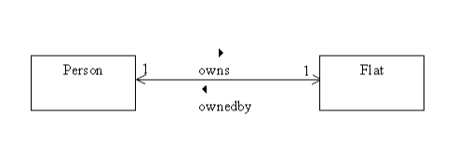
Case1: One to One Bidirectional Association

Slide 30
Java Code
public class Person {
public Flat owns;
}
public class Flat {
public Person ownedby;
}

Slide 31
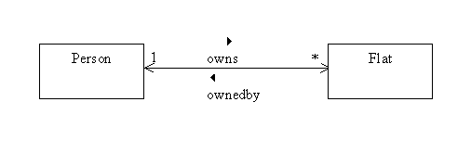
Case 2: One to Many Bidirectional Association
Case 2: One to Many Association

Slide 32
Java Code
import java.util.*;
public class Person {
public Collection owns;
}
public class Flat {
public Person ownedby;
}

Slide 33
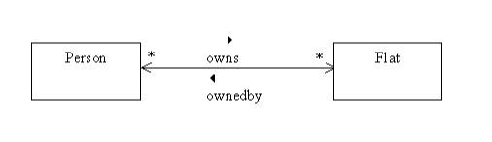
Case 3: Many to Many Bidirectional Association
Case 3: Many to Many Association

Slide 34
The Java Code for Bidirectional Association
import java.util.*;
public class Person {
public Collection owns;
}
import java.util.*;
public class Flat {
public Collection ownedby;
}

Slide 35
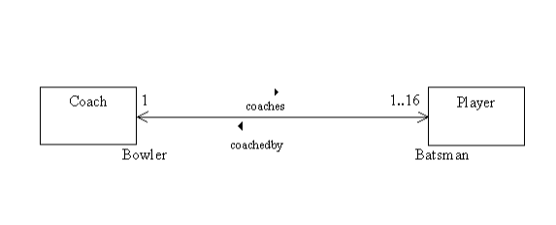
Role Names
  A string placed at the end of an association
near the class to which it applies.
  It denotes the role played by the class with respect to the association.

Slide 36
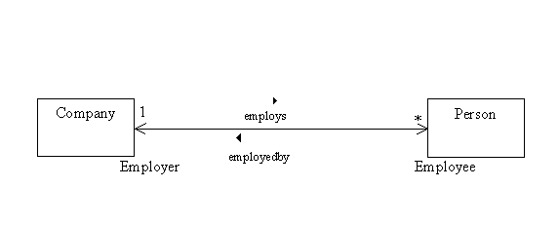
Qualified Association
  Consider a Company employing many people.
  The class diagram for ‘Company employs Person’ is shown
below.
Suppose we want to distinguish each employee on the basis of empID

Slide 37
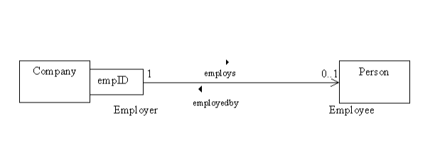
Qualified Association contd..
  Qualifier "empID" distinguishes among the set of objects of the class Person at the many end of an association.
  Indicates how the person is identified by the company
  Qualified Association is drawn as a small box at the end of an association near the class from which the navigation should be made.

Slide 38
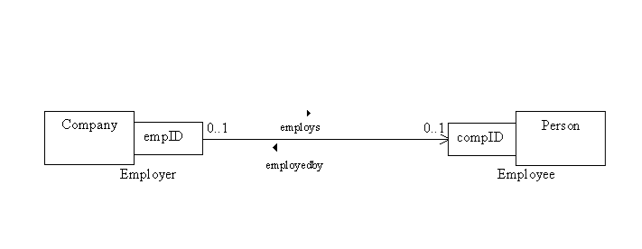
Qualified Association contd..
  Qualified associations can be used with 1 to many or many to many associations.
  If relationship between Company and Person was many-to-many then

Slide 39
Association Class
  Consider the relationship “Person rents Flat."
  Details of the rent like the amount, mode of payment of rent etc are not the properties of the class Person or of the class Flat.
  These are properties of the association "rents".
  So an association class called "Rent" can be made and the properties of rent can be included in it. Operations can also be added to this class.

Slide 40
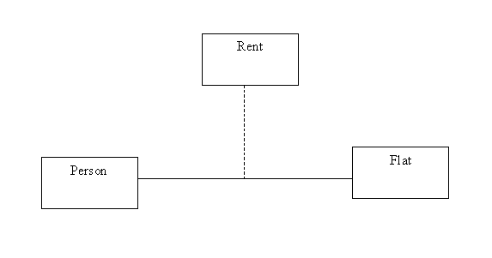
Depicting an Association Class

Slide 41
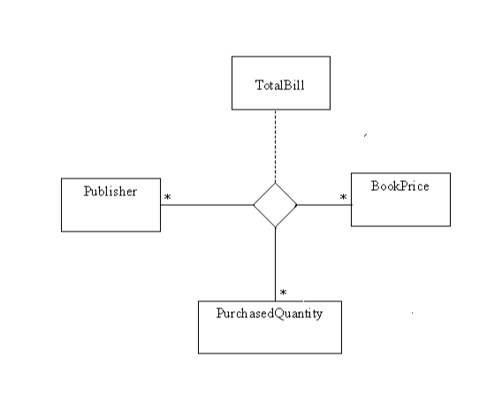
Ternary Association
  A many-to-many association between three classes.
  Represented by a hollow diamond.

Slide 42
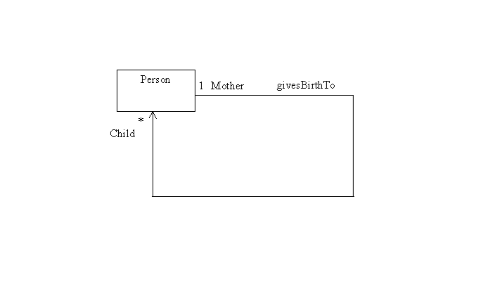
Recursive Association
  Association of a class to itself.
  E.g. One Person (Mother) can give birth to other persons (Children).

Slide 43
Java Code for Recursive Association
import java.util.*;
public class Person {
public Collection givesBirthTo;
}
Within a class Person, there will be a reference to a
collection of Persons

Slide 44
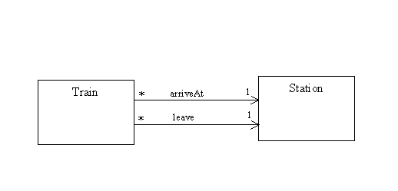
Multiple Associations between Two Classes
  Two classes can have multiple associations between them.
  E.g. Many trains can arrive at a station and many trains can leave a station.

Slide 45
Java Code for Multiple Associations
public class Train {
public Station arriveAt;
public Station leave;
}
public class Station {
}

Slide 46
Composite Aggregation
  Aggregation indicates that the relationship between classes is whole-part. There are two types of Aggregations: composite aggregation and shared aggregation.
  Composite Aggregation-A whole-part association between two classes such that the parts reside within the whole.
  Destruction of the whole results in automatic destruction of the parts.
  Multiplicity on the part side can be many but on the whole side it has to be zero or one.
  Denoted by a filled diamond

Slide 47
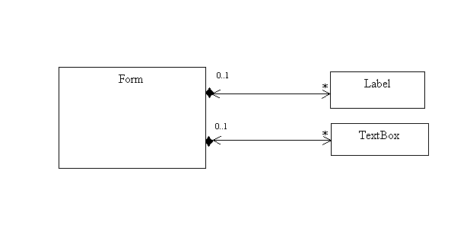
Depicting Composite Aggregation

Slide 48
Java Code for Composite Aggregation
import java.util.*;
public class Form {
public Collection myLabel;
public Collection myTextBox;
}
public class Label {
public Form myForm;
}
public class TextBox {
public Form myForm;
}

Slide 49
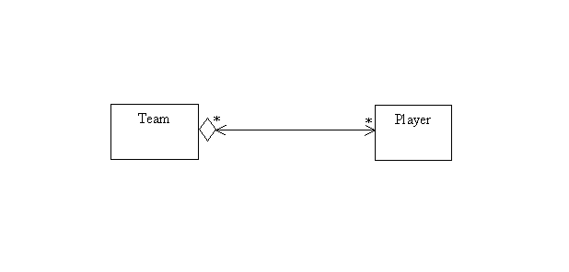
Shared Aggregation
  A whole-part association between two classes such that a part can reside within many wholes at the same time.
  Multiplicity on the part side can be many but on the whole side it has to be other than one.
  Denoted by a hollow diamond.

Slide 50
Java code for Shared Aggregation
import java.util.*;
public class Team {
public Collection myPlayer;
}
import java.util.*;
public class Player {
public Collection myTeam;
}

Slide 51
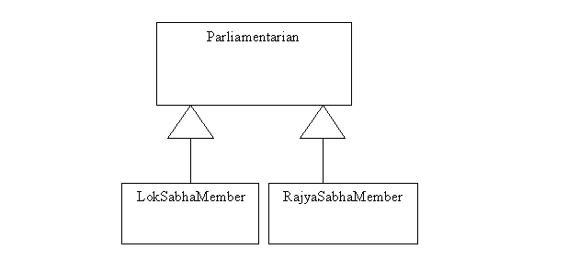
Generalization
  An association between a general class and more specific class (es).
  The specific class (es) contains extra behaviour of its/their own.
  The general class is called as the base class or superclass and the more specific class is called as the derived class or subclass.

Slide 52
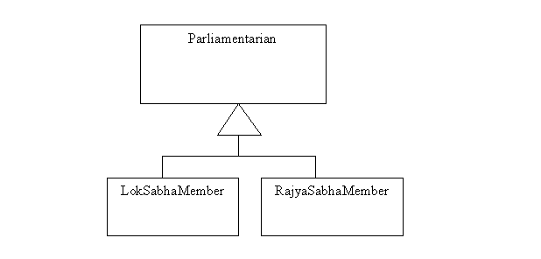
Generalization contd..
  It can also be represented as:

Slide 53
Java Code for Generalization
public class Parliamentarian {
}
public class LokSabhaMember extends Parliamentarian {
}
public class RajyaSabhaMember extends Parliamentarian {
}

Slide 54
Abstract Class
  A class that is not allowed to have any instances.
  Attributes and operations are only declared within this class.
  Subclasses inherit these features from the abstract class.
  Each subclass will have its own definition for each method declared in the abstract superclass.
  Represented by italicizing the superclass or using the keyword {abstract} beside the superclass name in the name compartment of the superclass.
  A class that has one abstract operation is compulsorily an abstract class.
  A subclass that inherits from an abstract superclass must implement all operations of that superclass or itself become abstract.
  Abstract operations are denoted by the keyword {abstract} beside the operation declaration.

Slide 55
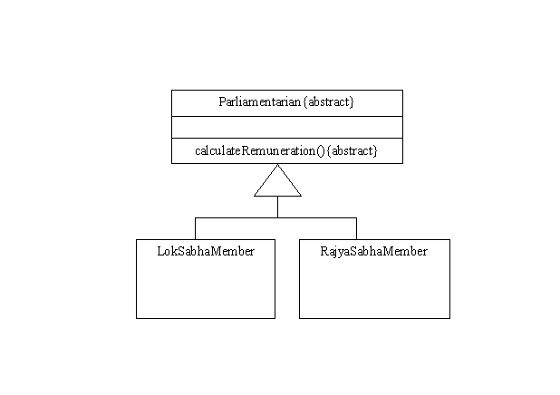
Depicting an Abstract Class

Slide 56
Java Code for Abstract Class
public abstract class Parliamentarian {
abstract public void calculateRemuneration();
}
public class LokSabhaMember extends Parliamentarian {
public void calculateRemuneration(){
//code to be included here
}
}
public class RajyaSabhaMember extends Parliamentarian {
public void calculateRemuneration(){
//code to be included here
}
}

Slide 57
Subclass Partitioning
  Depicts the manner in which a class is partitioned into subclasses. 4 types:
  Complete: A type of subclass partitioning in which the mentioned subclasses are the only subclasses of the superclass. No other class is allowed to inherit from the superclass.
  Disjoint: A type of subclass partitioning in which no class can inherit from more than one subclass of the superclass.

Slide 58
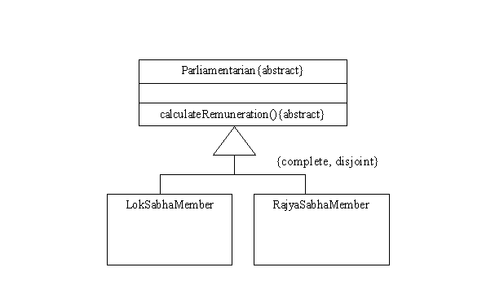
Subclass Partitioning contd..

Slide 59
Subclass Partitioning contd..
  Incomplete: A type of subclass partitioning in which the mentioned subclasses are not the only subclasses of the superclass.
  It does not mean that the modeler intends to add them later.
  It only means that they are not relevant to the model.

Slide 60
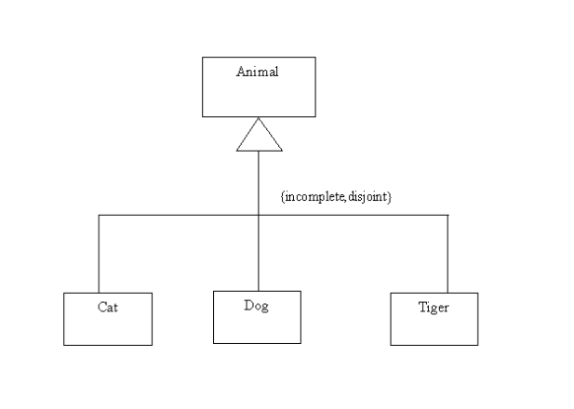
Subclass Partitioning contd..

Slide 61
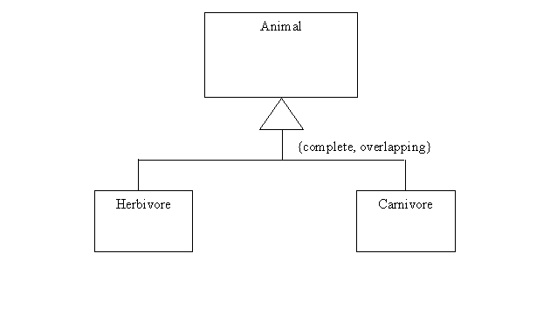
Subclass Partitioning contd..
  Overlapping: A type of subclass partitioning in which a class can inherit from more than one subclass of the superclass.An Omnivore can inherit from both a Herbivore and a Carnivore.

Slide 62
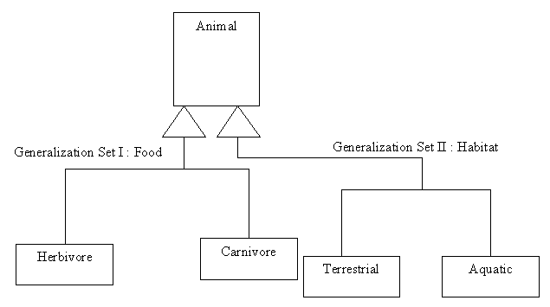
Generalization Set
  A set depicting the basis of partitioning of a superclass into subclasses. A superclass can be partitioned into subclasses based on different generalization sets at the same time.

Slide 63
Interface
  An Interface contains only method signatures.
  They do not specify any implementation neither they are allowed to have any attributes.
  Represented by a rectangle having two compartments.
  Convention is to write <<interface>> and its name on the next line of the first compartment.
  The second compartment consists of the method names and signatures of the interface

Slide 64
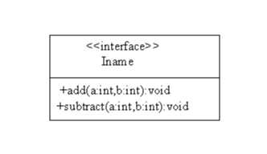
Depicting an Interface

Slide 65
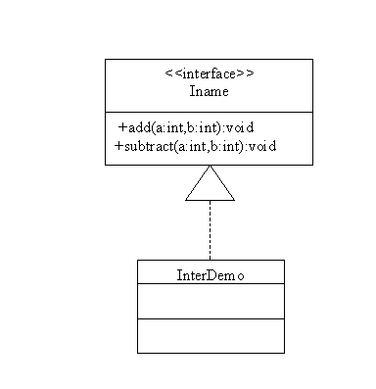
Interface Realization
  A class must implement all methods in the interface.

Slide 66
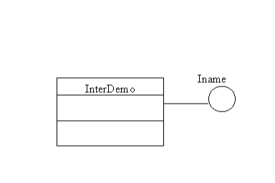
Interface Realization (Compact Notation)

Slide 67
Java Code for Interface Realization
public interface Iname {
public void add(int a,int b);
public void subtract(int a,int b);
}
public class Interdemo implements Iname {
public void add(int a,int b){
//code to be written here
}
public void subtract(int a,int b){
//code to be written here
}
}

Slide 68
Package
  A Package is used to group elements into a unit and to give a name to the unit.
  It can never be instantiated.
  All the elements that are owned or referenced by a package are called its contents.
  The removal of a package results in the automatic removal of all its contents.
  The contents of a package can include other packages, interfaces, components, nodes etc.

Slide 69
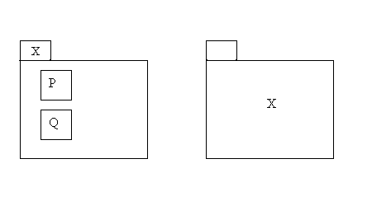
Package Notations

Slide 70
Packages and Classes
  Suppose there are two packages P1 and P2. Both of them can have the same class A and these classes are distinguished by their path-names. So P1::A and P2::A are distinct.
  Suppose a package P3 contains a class "A". If P3 is nested within another package P2 and P2 is nested within a package P1, then the complete name for class "A" is P1::P2::P3::A
  Avoid more than three levels of nesting

Slide 71
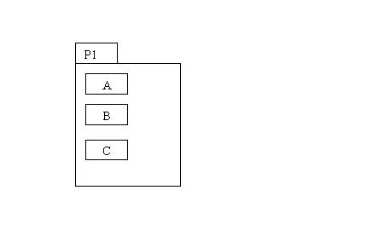
Graphical Display of Owned Elements

Slide 72
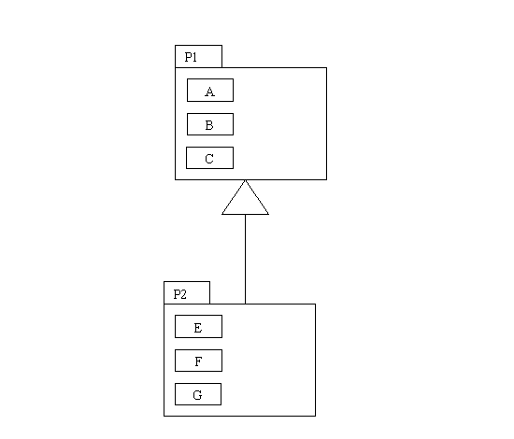
Package P2 extends Package P1

Slide 73
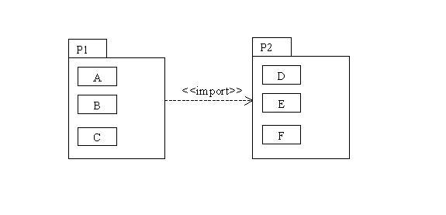
The import dependency
  Consider two packages P1 and P2 with the elements A and B respectively.
  Suppose P1 imports P2.
  It means that the public elements of P2 are visible to the elements of P1.
  Consider the figure: Class A can now access class D but not vice-versa.

Slide 74
The access dependency
  Specifies that the public elements of the target package are visible to the elements of the source package with one fundamental difference with import dependency.
  The import dependency adds the contents of the target package to the source package's namespace and so their names don’t have to be qualified. However this makes the elements susceptible to clashes.

Slide 75
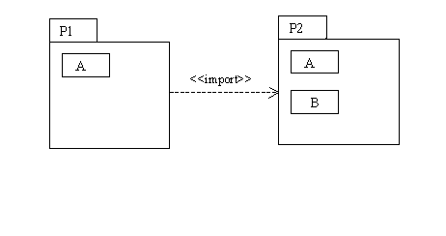
Clash of names if import dependency is used
  E.g. There will be a clash of names here because P2::A will be added to P1.

Slide 76
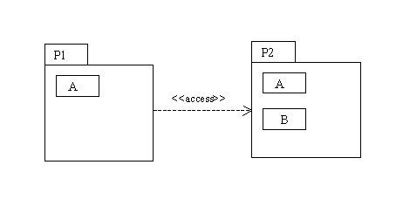
Depicting the access dependency
  The <<access>> stereotype does not add the contents of the target to the source package

Slide 77
The access dependency
  There will not be any clash of names here because P2::A would not be added to P1. Package P2's class A will be referred to as P2::A.
  Qualification of names is mandatory.
  The public parts of a package are called its exports.
  Import and Access dependencies are not transitive.

Slide 78
Guidelines to group classes into a package
  Classes belonging to the same inheritance hierarchy.
  Classes among which composition relationship is present.
  Classes that collaborate a lot of information among themselves as indicated by interaction diagrams.

Slide 79
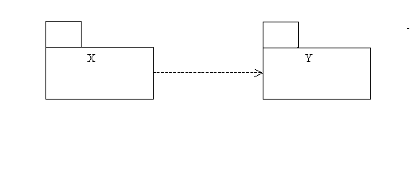
Dependency
  One class A depends on another class B if changes to B will cause changes to A. Suppose a class A in Package X depends on class B in package Y, then we can safely say that "Package X is dependent in Package Y". While designing it is important to minimize dependencies between packages.
  E.g. the dependency of package X on package Y

Slide 80
Parameterized Classes
  Used to create a family of classes.
  E.g. Suppose there is a parameterized class for an Array. An array of integers, floating-point numbers, characters etc can be created from it.
  Consider a class named ArrayType. Suppose there are two methods within the class i.e. insert() which takes an element and inserts it in the array and delete() which takes an element from the user, checks to see if it is in the array and then deletes it if it is present.

Slide 81
Parameterized Classes contd..
class ArrayType <E>{
void insert( E anElement);
void delete(E anElement);
}
  Possible to have ArrayType <intI> IntegerSet or ArrayType <doubleD> DoubleSet.
  When a generic class is used, intI and doubleD are called as bound elements.

Slide 82
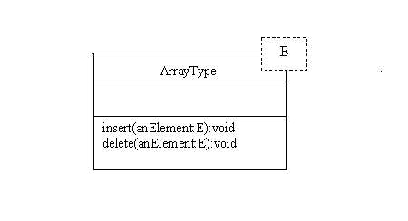
Depiction of a Parameterized class

Slide 83
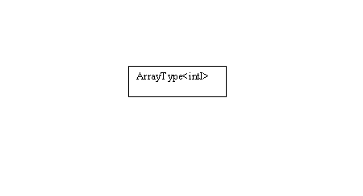
Depiction of Bound Elements

Slide 84
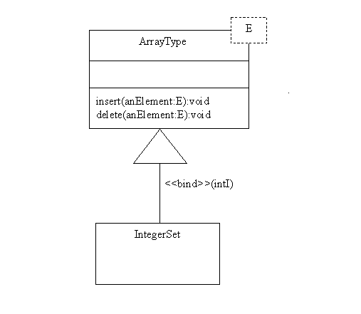
Depiction of Bound Elements

